Slide 1
Cyclist (2019 – 2020)
Manu Shyam

Slide 2
Introduction
Good morning everyone! I'm thrilled to be here today to delver into the future of Cyclist and explore the key questions that will shape our marketing program. Today, we embark on a journey to uncover the unique characteristics of our user base and pave the way for membership growth.

Slide 3
The Three Guiding Questions
Our exploration will revolve around three crucial questions that will guide our future marketing efforts:
How do annual members and casual riders use Cyclist bikes differently?
Why would casual riders buy Cyclist annual memberships?
How can Cyclist use digital media to influence casual riders to become members?
Join me as we unravel the answers to these questions and strategize our way towards enhancing user experience and membership engagement.

Slide 4
Agenda Overview
User Behavior Analysis: Uncovering patterns and distinctions between annual members and casual riders.
Motivations for Membership: Exploring the factors that drive casual riders to become annual members.
Digital Media Influence: Crafting strategies to leverage digital media for membership conversion.

Slide 5
User Behavior Analysis
From the data I’ve collected and analyzed we can see a clear difference in usage of rides between the Customers and Subscribers.

Slide 6
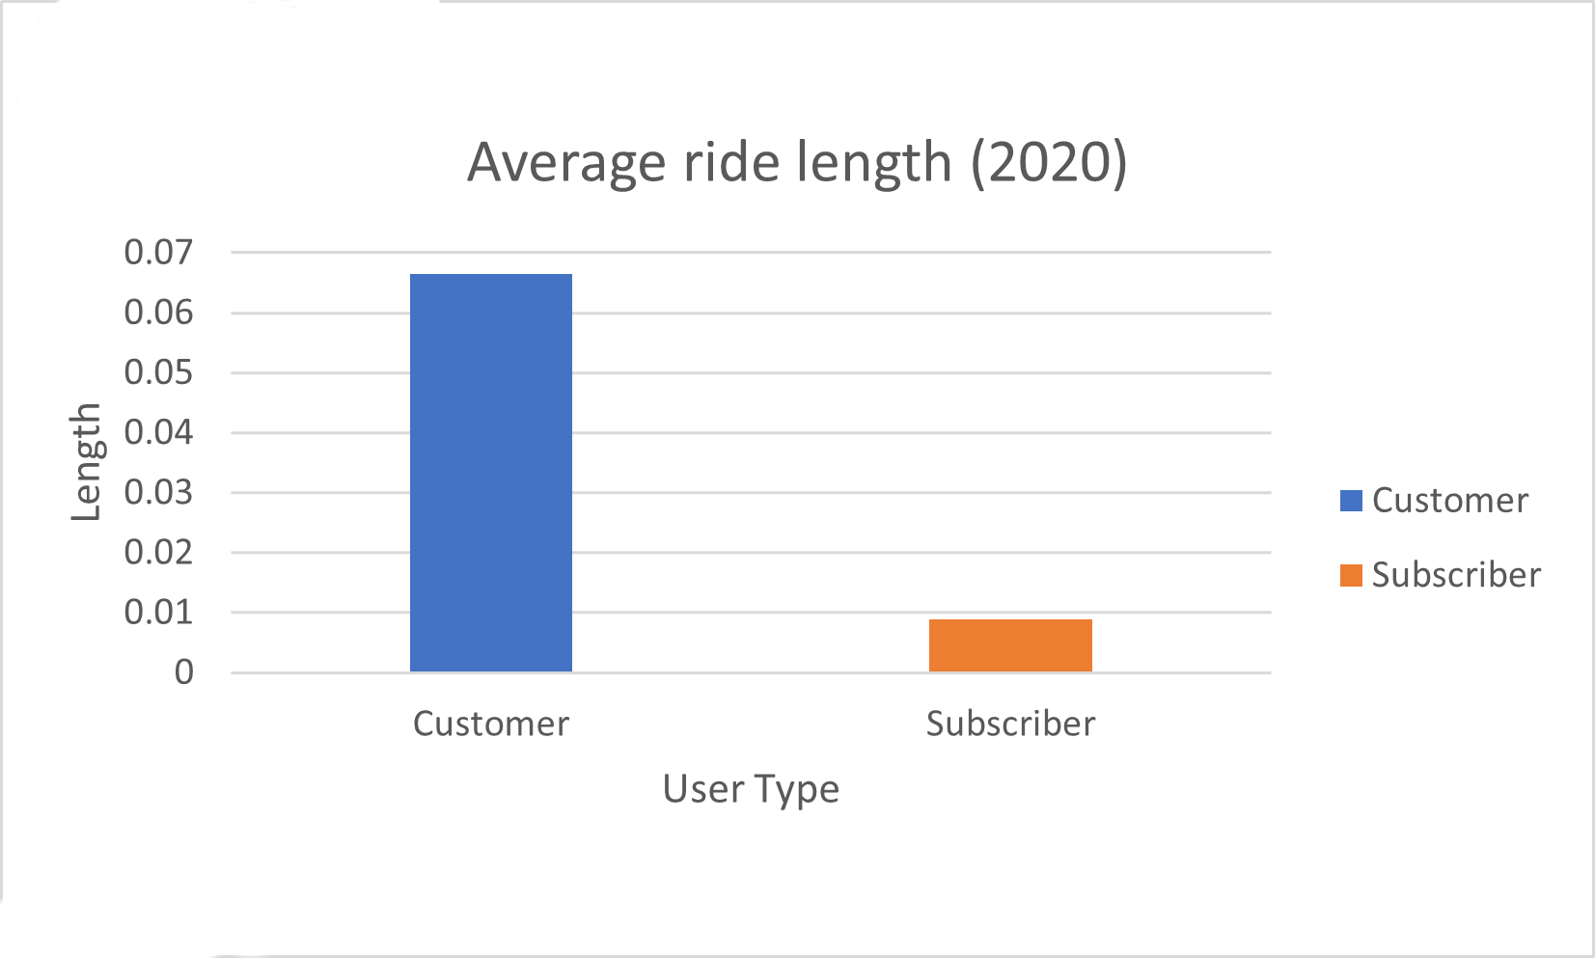
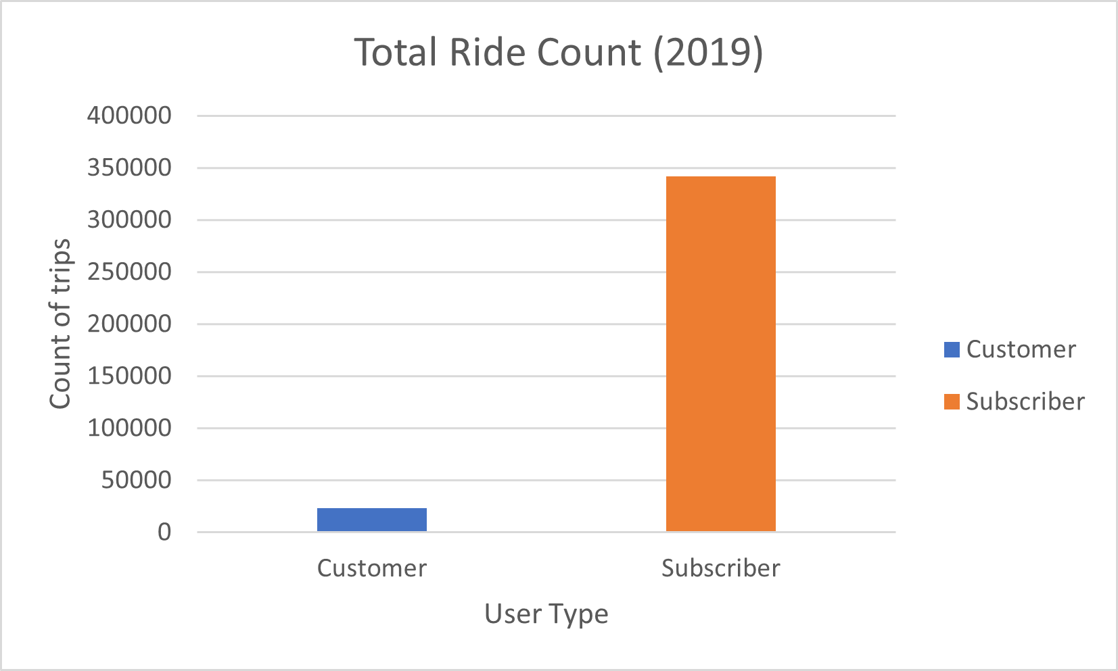
2019 Usage

Slide 7
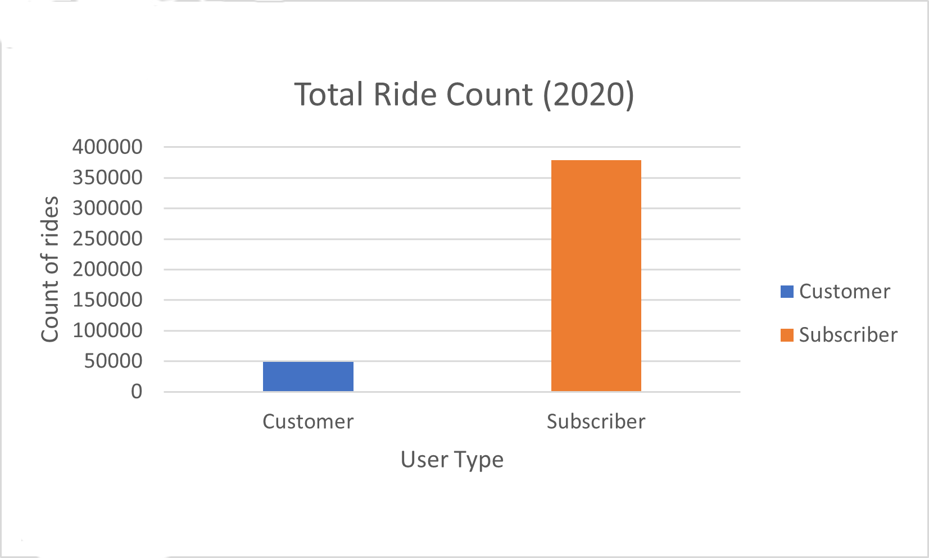
2020 Usage

Slide 8
User Behavior Analysis
Frequency of Use: Annual members are more likely to use the bikes regularly, as they have committed to a longer-term membership. They may use the service for daily commuting or frequent short trips.

Slide 9
Why would casual riders buy Cyclist annual memberships?
Cost Savings: Offer promotions or discounts to demonstrate the potential cost savings of an annual membership compared to pay-per-ride fees.
Incentives and Rewards: Implement a loyalty program that rewards frequent users with perks such as free rides, exclusive discounts, or partner offers.
Exclusive Access: Provide annual members with exclusive access to certain bikes, priority parking spots, or other privileges to make the membership more appealing.

Slide 10
Digital Media Influence
Targeted Advertising: Utilize targeted digital advertising on social media platforms and other online channels to reach potential casual riders. Highlight the benefits of annual memberships and any ongoing promotions.
Engaging Content: Create engaging and shareable content that showcases the convenience, cost savings, and positive experiences of annual members. This could include user testimonials, success stories, or short video clips.
Limited-Time Offers: Use digital media to promote limited-time offers or discounts for annual memberships, creating a sense of urgency and encouraging casual riders to make the switch.
Educational Campaigns: Run digital campaigns that educate casual riders about the advantages of annual memberships, emphasizing factors like convenience, flexibility, and overall value.

Slide 11
Thank You

